Slide 1
Sprint 0 CB06-Group 4
Emanuil Karapachov
Vlad Cojocariu
Stanimir Nikolov
Wondimu Woldeaarggiye
Oliver van Eldonk

Slide 2
Agenda
Our concepts
Sitemap
User Stories
Requirements
Questions/Planning for the next sprint

Slide 3
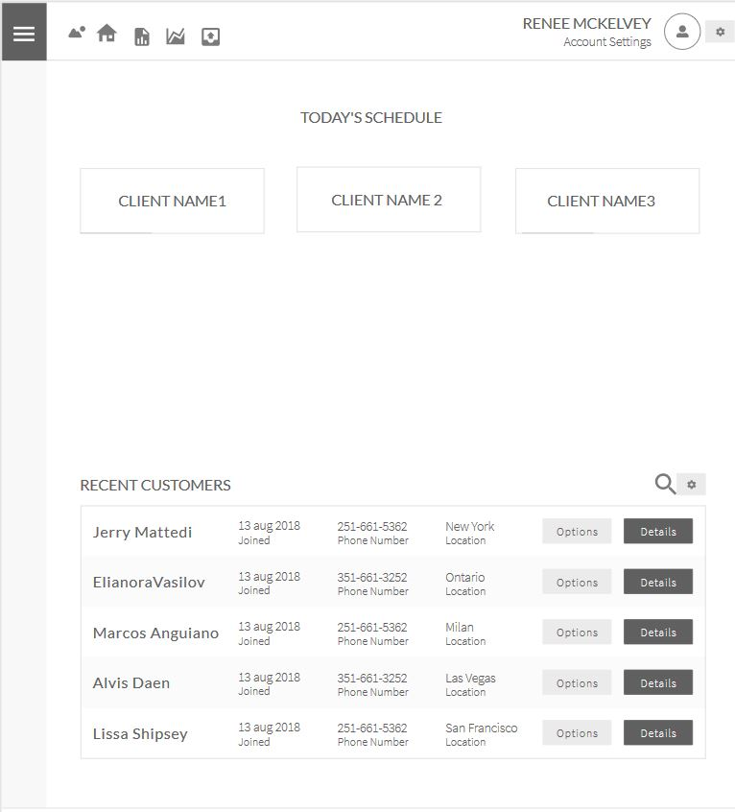
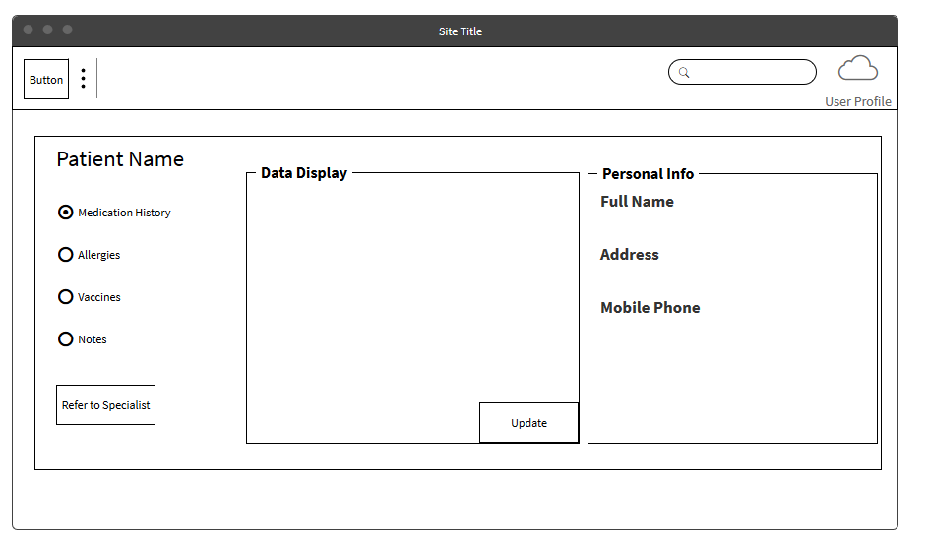
A first look of the app

Slide 4
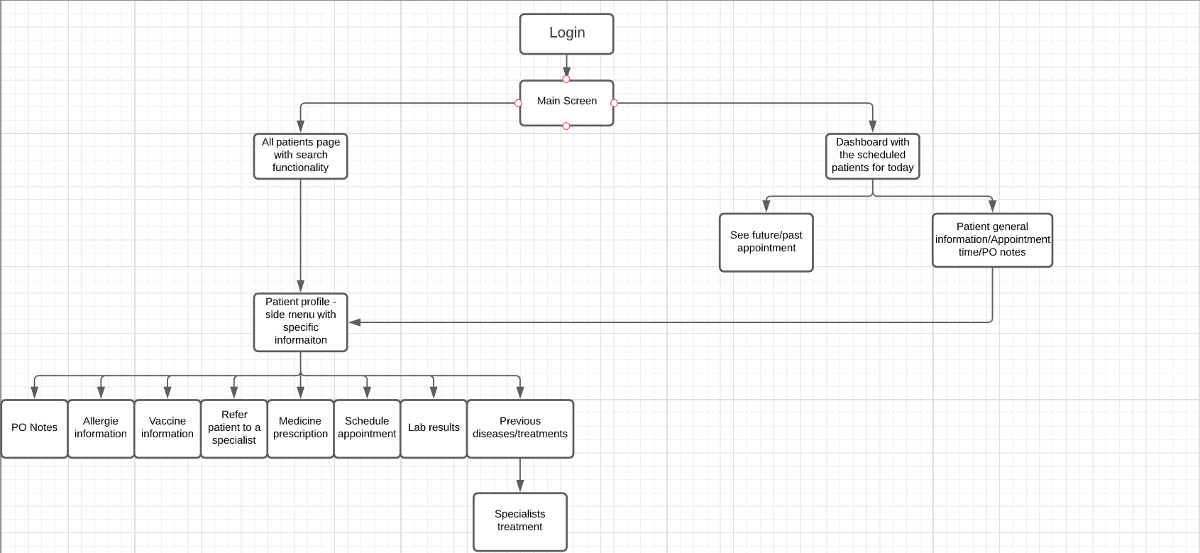
Pharmapartners app - Sitemap

Slide 5

User stories and use cases
What do GPs need this solution for?
How and when are they going to use it?

Slide 6


A general practitioner would like to be able to:
Update/modify patients’ data
Prescribe a medication
Referral
See patients’ treatment history
See patients’ medication history
See patients’ allergies & vaccination status
See patients’ contact information
See past and upcoming appointments
Cancel an appointment

Slide 7



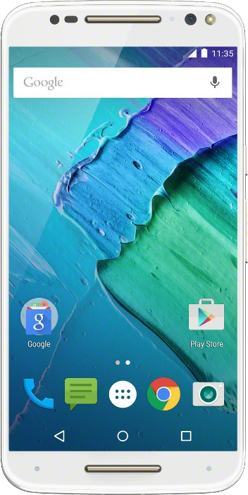
With mobility and portability in mind

Slide 8


Requirements
Notes:
Log into the system - Must
Reset email password. Should
Future/past appointment. - Must
Laboratory results. -Must
Patient medical treatment history- Must
Patient medication history. - Must
Patient list of allergies. - Must
Vaccines history. - Must
Diseases/medicine update information. Could
Referral - Must
Order medication. - Must
Contact information - Must
Modify/update patient information. -Must
Take a note. Must

Slide 9

Client Questions
Notes:
Does the client want a disease history categorised by chronic diseases, acute disease, subacute disease?
Does the client want to be able to see medical letters from the specialists attached to the file?
Also does he/she want to see the hospital discharge tickets?
Would you like to see the available pharmacies, Hospitals, Dentist clinics and Physiotherapies in that area?
Would you like to have a Dashboard, with the main information about a patient
Which are the things, the Medic, is allowed to change?
We would like to know exactly which kind of information that we need to show? About a patient, about the health topics.
Your online agile management environment is ready for sprint 1 and the proper stakeholders have access?
Does the PO want access to the git repository?
Does the GP can add patients to the system?

